Slide 1

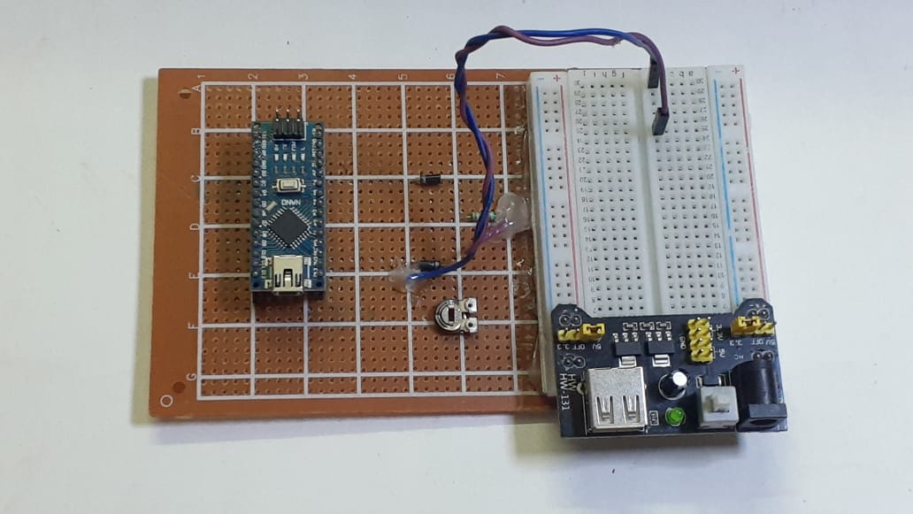
ARDUINOSCOPE

Slide 2
INDEX
INTRODUCTION
WHAT IS DSO??
DSO WAVEFORM
ARDUINOSCOPE
COMPONENTS REQUIRED
CIRCUIT DIAGRAM
APPLICATION
FUTURE ASPACTS
CODE
SOFTWARE
ADVANTAGE & DISADVANTAGE
CONCLUSION
REFERENCE

Slide 3
INTRODUCTION
It is a microcontroller based oscilloscope( Arduino Nano).
PC based oscilloscope score over standalone oscilloscope due to their compact size, low cost and ability to do offline analysis.
It is made up of very few components, so that everyone can afford it. Generally, the cost of an oscilloscope is around Rs.50,000 to 60,000. But this arduinoscope which is made by us is under the budged of Rs.1000.
This is a DIY Oscilloscope and its work is to measure frequency, waveforms and determine voltage levels.
Atmega 328p SMD microcontroller is used and also Arduino Nano is implemented.
As it is reprogrammable , if we have any issue we can change it so easily , and it is also having PMW signal generator with the help of this we can change amplitude duty cycle etc.

Slide 4
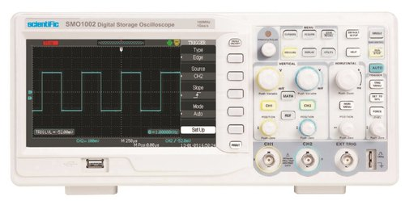
WHAT IS DSO??
A digital storage oscilloscope (DSO) is an oscilloscope which stores and analyses the input signal digitally rather than using analog techniques. It is now the most common type of oscilloscope in use because of the advanced trigger, storage, display and measurement features which it typically provides.

Slide 5
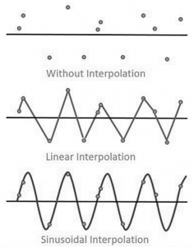
DSO WAVEFORM
There are two types of waveform reconstructions they are linear interpolation and sinusoidal interpolation.
1.Linear Interpolation:- In Linear interpolation, the dots are joined by straight Line.
2.Sinusoidal Interpolation:- In sinusoidal interpolation, the dots are joined by sine wave.

Slide 6
ARDUINOSCOPE
The name of our project is ‘Arduinoscope’. It is an arduino and microcontroller based oscilloscope are an essential tool for electronics hobbyists and professionals to verify that their designs would work as expected. PC based oscilloscope score over standalone oscilloscope due to their compact size, low cost and ability to do offline analysis.

Slide 7
COMPONENTS REQUIRED
Components | PRICE
ARDUINO NANO X 1 | 300/-
IN4007 DIOD X 2 | 10/-
330KOhm Resistor X 1 | 5/-
10K Potentiometer X2 | 50/-
Breadboard X 1 | 100/-
Breadboard power supply X 1 | 100/-
PCB X 1 | 35/-
ARDUINO UNO X 1 | 400/-
TOTAL:-- | 1000/-

Slide 8
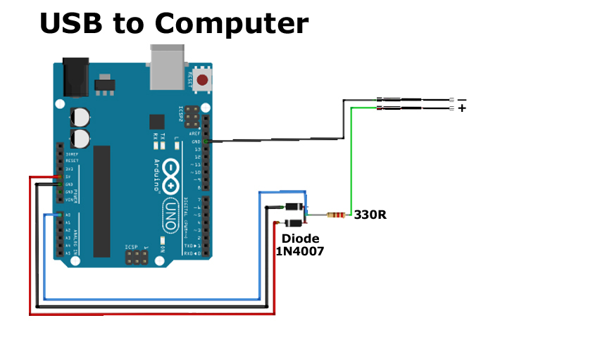
CIRCUIT DIAGRAM

Slide 9
APPLICATION
1. Arduinoscope can be used in different electronics projects, especially in micro electronics work as it is very compact enough for a single person to carry.
2. The professional level oscilloscope comes under Rs.50,000 to 60,000 but arduinoscope is very low cost and compact under Rs.1000 and is almost similar with professional level.
3. The PWM signal is released which is used in different projects and in DIY projects.
4. It is very easy and simple to use. It works by connecting it to the PC and not having any external display , just plug and use.
5. It is safe and secure and by installing the software in the PC, it will give the satisfied results. The set-up is quite simple and straightforward.

Slide 10
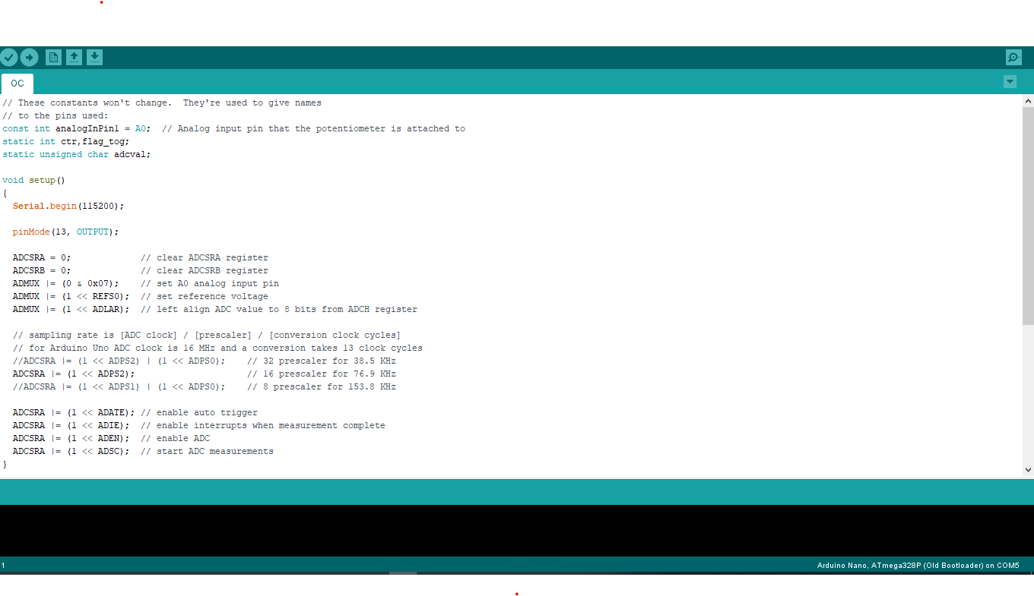
CODE

Slide 11
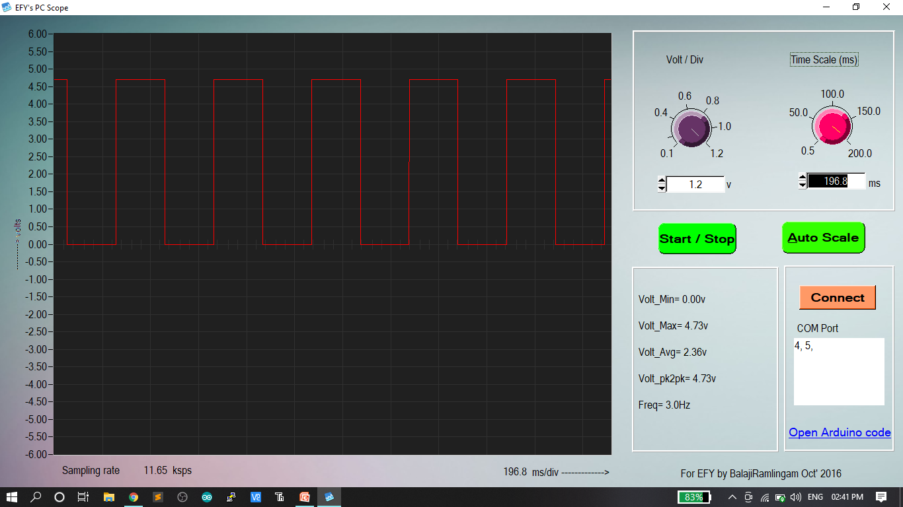
SOFTWARE

Slide 12
ADVANTAGES & DISADVANTAGES
Advantage
Disadvantage
The set-up is very easy to handle and straightforward.
It is almost similar with professional level oscilloscope.
It is very low cost and compact , quite simple.
We will get approx right reading once we connected.
It does not create any noise.
It is not accurate and having some % of error.
PC is must as there is no external display.
But now it is in open, no case is used to protect, may be in future.
It can not analyze high frequency sharp rise.
It will only analyze in real time as there is no storage memory.

Slide 13
FUTURE ASPACTS
In future, we can upgrade our ‘Arduinoscope’ in many ways. First of all, it is having signal channel which we can later develop it into double channel . Secondly , also we can upgrade the software which will make it more advance . Thirdly we can add storage memory , with the help of it data can be storage for a long time . Fourthly , we can add case to protect it from dust and to look more attractive and unique. Fifth , we will try to look more addition of more features to make it more accurate . So that it will be use in other electronics projects.

Slide 14
CONCLUSION
In This Project , We Learned the study of Arduino ,and successfully made the pc based Arduinoscope, which is very helpful and an important electronics device. We gave our best to make this project “Arduinoscope” compact and in low cost under the budget of Rs.1000/-
We are very glad to complete this project with in the prescribed time and come across many new technologies. We want to convey our thanks to all who help us in different ways.

Slide 15
REFERENCE
https://en.wikipedia.org/wiki/Digital_storage_oscilloscope
https://en.wikipedia.org/wiki/Pulse-width_modulation
https://www.arduino.cc/en/guide/introduction
https://www.allaboutcircuits.com/video-tutorials/ac-and-dc-signals/
https://www.engineersgarage.com/what_is/what-is-breadboard/

Slide 16


